Slide 1



Placement portal management system
Team:
G Sirisha – 22N31A0582
G Alekhya – 22N31A0570
M Prem kumar – 22N31A05C7

Slide 2
ABSTRACT
Web-based application designed to streamline the placement process in educational institutions.
Core Modules
Student Module
- Manage placement journey: create and update profiles.
- Upload personal details, academic records, and resumes.
- Track application status and receive notifications about placement activities and interviews.
Staff Module
- Management capabilities for faculty and placement officers.
- Monitor student submissions and verify placement details.
- Download offer letters and generate customized student lists.
- Coordinate efficiently with recruiting companies and schedule interviews.
Admin Module
- Full administrative control: manage user roles and permissions.
- Modify student academic records for data accuracy.
- Generate detailed reports for insights into placement activities.

Slide 3
PROPOSED SYSTEM
Advantages of Proposed System Placement Portal Management System:
- The system enhances the efficiency of the placement process by automating manual tasks.
- It offers a centralized platform, improving communication and coordination between students, staff, and companies.
- The system is user-friendly and accessible, with a simple interface for all users.
- With its ability to track, monitor, and generate reports, the system allows for better organization and data management.
- It reduces administrative workload, allowing staff and administrators to focus on more critical tasks related to student placements.

Slide 4
LITERATURE SURVEY
The development of the Placement Portal Management System is informed by an extensive body of research on various components that are central to managing the placement process in educational institutions. A wide range of studies and papers provide valuable insights into the evolution of web-based management systems, student information systems, and recruitment coordination frameworks, all of which have contributed to the understanding and design of this system.

Slide 5
[1] "A Survey on Student Information Systems" (Journal of Educational Technology & Society, Vol 22, March 2017)
This paper reviews the design and implementation of student information systems (SIS) used in educational institutions to manage student data and academic records. The study highlights the importance of SIS in streamlining administrative processes, including enrollment, course management, and record keeping, which are crucial for maintaining accurate placement data. The paper also discusses the integration of such systems with external platforms to facilitate better communication between students, faculty, and recruiters. The insights from this study provide the foundation for the Student Module of the Placement Portal, which manages student profiles and academic records.
[2]"Web-Based Systems for Recruitment Management: A Survey" (International Journal of Computer Applications, Vol 128, June 2016)
This survey explores various web-based systems designed for recruitment management, focusing on how these platforms enable the coordination between educational institutions and companies. The paper emphasizes the role of such systems in improving the efficiency of campus recruitment by automating job postings, resume submission, and interview scheduling. The survey’s findings underline the necessity of creating a centralized platform where students, staff, and companies can interact seamlessly. This research directly informs the design of the Placement Portal’s Staff Module, which enables faculty and placement officers to coordinate interviews, track student applications, and interact with recruiters.
[3]"Automating Placement Activities Using Web Portals: A Case Study" (IEEE Access, Vol 6, July 2018)
This case study delves into the challenges faced by educational institutions in managing placement activities manually and discusses the advantages of automating these tasks through web portals. It highlights the impact of automation on reducing administrative burdens, improving data accuracy, and enhancing the overall experience for students and staff. The study's findings emphasize the importance of features like real-time notifications, application tracking, and automated reporting, all of which are incorporated into the Placement Portal Management System to streamline the placement process and provide real-time updates.

Slide 6
[4]"Role of Cloud-Based Solutions in Student and Placement Management" (ACM Computing Surveys, Vol 50, January 2019)
This paper examines the use of cloud-based technologies in managing educational data, including placement activities. It highlights the scalability, flexibility, and security benefits of cloud-based systems, which are increasingly used in educational institutions for managing student information and placement data. The findings of this study have informed the design of the Placement Portal’s backend architecture, ensuring that it is scalable and secure, particularly in handling large volumes of data related to student profiles, academic records, and company interactions.
[5] "Enhancing Student Engagement in Placement Processes through Technology" (Journal of Higher Education Policy and Management, Vol 42, April 2020)
This research focuses on how technology can enhance student engagement in the placement process by providing better access to information, improving communication channels, and offering personalized services. The study underscores the importance of user-friendly interfaces and real-time data access, which improve the overall experience for students navigating the placement process. These insights have directly influenced the design of the Placement Portal’s user interface, ensuring it is intuitive and accessible for students of varying technical expertise.

Slide 7
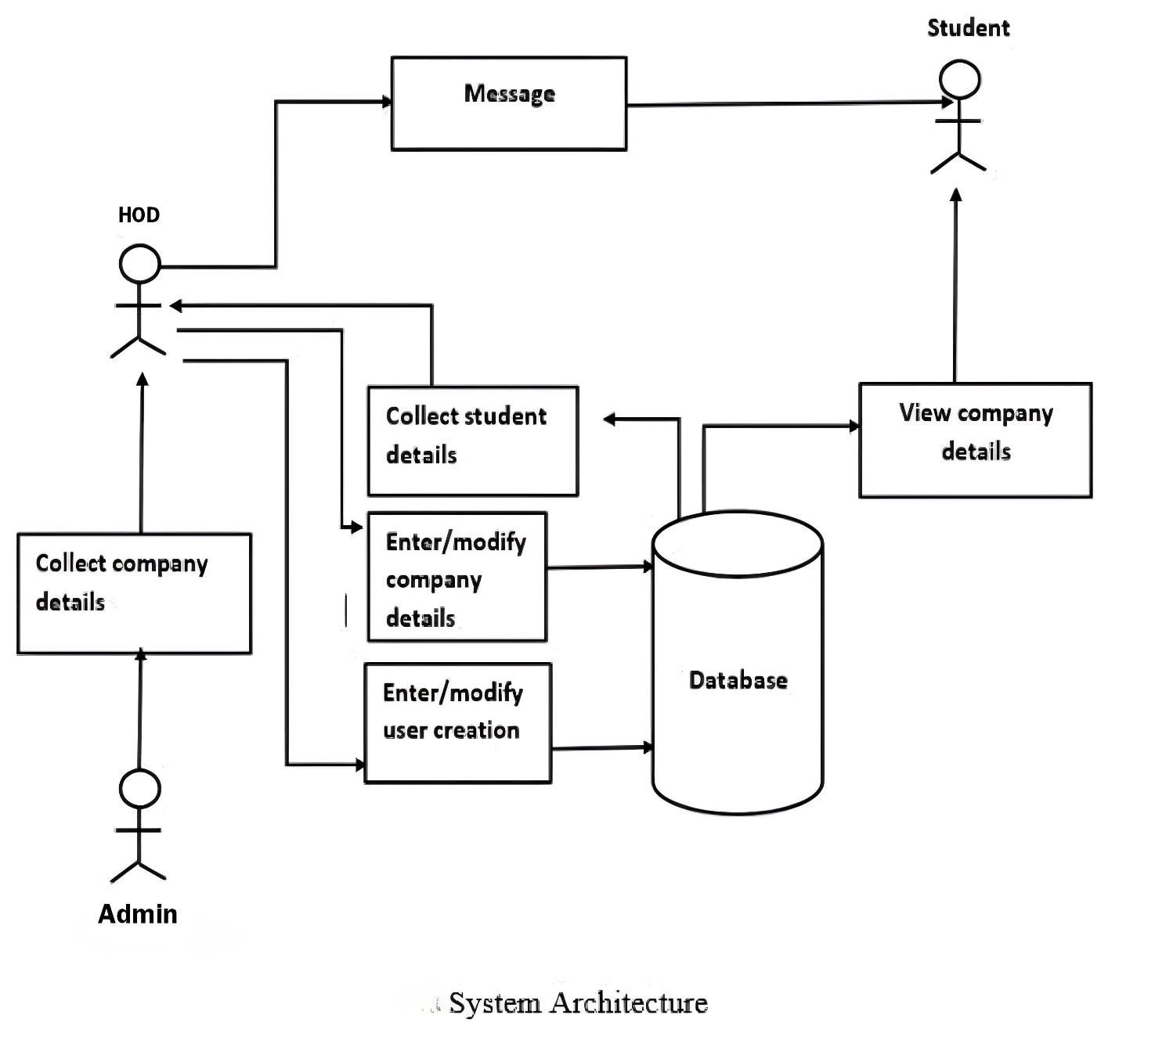
System architecture

Slide 8
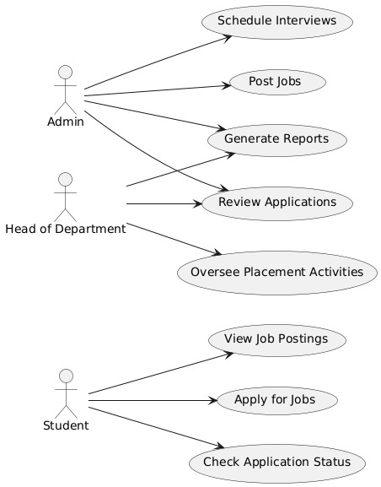
USEcase diagram

Slide 9
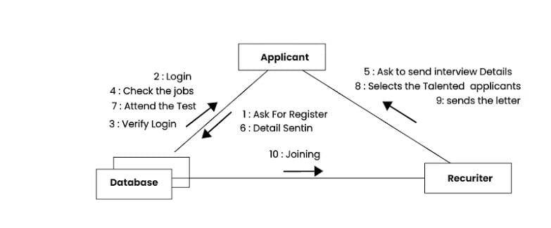
Collaboration diagram

Slide 10
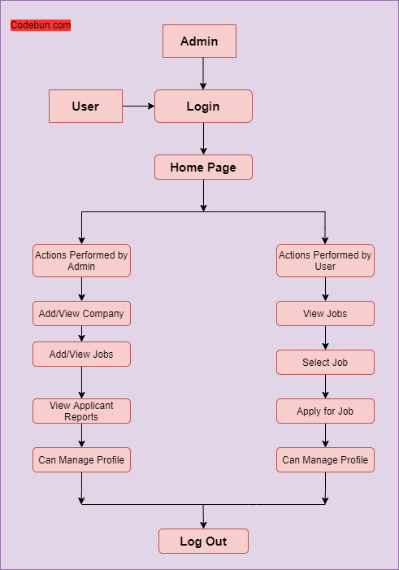
Data-flow diagram

Slide 11
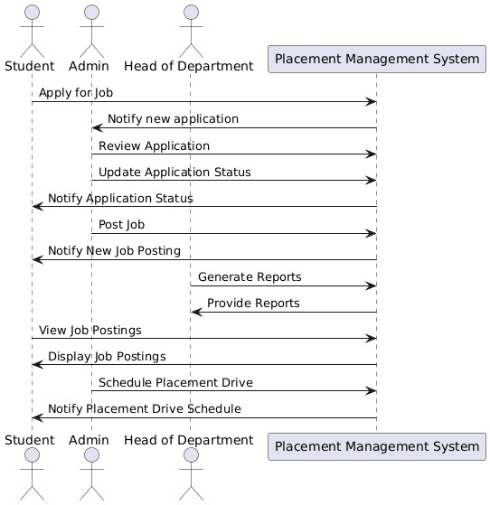
Sequence diagram

Slide 12
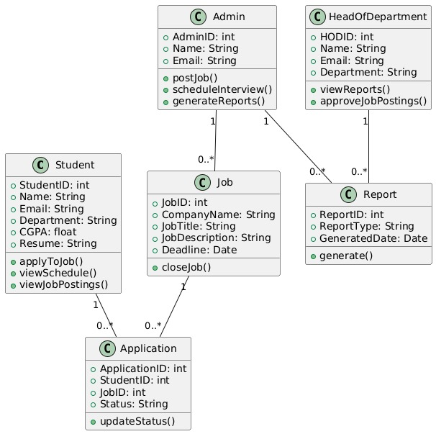
Class diagram

Slide 13
Module description
1. Student Module:
Registration and Profile Management: Allows students to register, create, and update their profiles with essential details such as personal information, academic background, skills, certifications, and resume upload.
View and Apply for Job Openings: Students can view available job opportunities, filter them based on their preferences, and apply directly through the portal.
Application Status Tracking: Students can track the status of their applications (e.g., applied, shortlisted, interview scheduled, selected/rejected).
Notifications and Announcements: Provides updates on upcoming recruitment drives, deadlines, and important announcements from the placement office.
Placement Statistics: Allows students to view previous placement records and statistics, helping them understand trends and set goals.

Slide 14
2. Staff Module:
Manage Student Profiles: Staff members can view and verify student details, resumes, and academic records to ensure eligibility for various job opportunities.
Job Posting Management: Enables staff to post job openings from different companies, specify eligibility criteria, and manage recruitment schedules.
Interview Scheduling and Coordination: Helps staff coordinate interview processes by scheduling dates, times, and notifying students and recruiters.
Communication with Recruiters: Facilitates communication between staff and company representatives for scheduling and clarifying requirements.
Generate Reports: Allows the generation of reports on student placement statistics, company participation, and recruitment trends for analysis.

Slide 15
3. Admin Module:
User Management: Admins can manage user accounts, including the creation and deletion of accounts for students and staff.
System Configuration: Provides options to configure the portal settings, such as deadlines, eligibility criteria, and access rights.
Manage Recruiters and Companies: Admins can onboard new companies, manage their profiles, and ensure smooth coordination between companies and students.
Track and Analyze Placements: Allows admins to monitor the overall placement process, track student performance, and analyze company feedback.
Reports and Analytics Dashboard: Provides an analytics dashboard with insights into placement success rates, company participation, student performance, and areas for improvement.

Slide 16
Future scope
Future Scope of Placement Portal Management System in College
Enhanced Student Engagement
Continuous updates to the platform to keep students engaged with placement opportunities and career resources.
Integration with Academic Programs
Align placement activities with academic calendars, ensuring students are prepared for job applications in sync with their coursework.
Career Counseling Services
Utilize the system for scheduling one-on-one counseling sessions to guide students in their career paths.
Workshops and Training Sessions
Organize skill development workshops directly through the portal, allowing students to register and participate in relevant training sessions.
Real-Time Feedback and Support
Provide a mechanism for students to receive real-time feedback on applications and interviews, helping them improve continuously.
Employer Collaboration
Strengthen partnerships with companies to facilitate regular recruitment drives and guest lectures through the system.
Data Analytics for Improvement
Use data analytics to assess placement success rates, identifying areas for improvement in student readiness and employer engagement.

Slide 17
conclusion
Conclusion of Placement Portal Management System
Enhanced Efficiency
Significantly improves the placement process within educational institutions.
Automates critical tasks for streamlined operations.
Seamless Communication
Facilitates effective interaction between students, staff, and administrators.
Core Modules
Student Module: Empowers students to manage profiles, upload resumes, track applications, and receive notifications.
Staff Module: Provides tools for faculty to verify submissions, schedule interviews, and coordinate with recruiters.
Admin Module: Offers control over system operations, including role management, permissions, and report generation.
Technical Capabilities
Leverages PHP and MySQL for efficient data management and user interaction.
Addressing Demand
Meets the need for digital-first solutions in educational institutions.
Reduces administrative burdens and enhances the overall placement experience for stakeholders.

Slide 18
references
T. Kumar, S. Sharma, and P. Singh (2022)
"Streamlining Placement Processes in Higher Education Using Web-Based Platforms"
Journal of Computer Applications in Education, vol. 45, no. 2, pp. 98-105.
doi: 10.1016/j.jcae.2022.101235.
A. Gupta, R. Pandey, and S. Verma (2023)
"Efficient Student and Company Coordination through Digital Portals in Campus Recruitment"
IEEE Conference on Innovations in Web Applications, pp. 230-238.
doi: 10.1109/CIWA2023.8971234.
J. Williams and T. Brown (2020)
“Automation of Placement Activities Using Web Technologies: An Overview”
Journal of Information Systems and Web Development, vol. 32, no. 4, pp. 455-460.
doi: 10.1016/j.jisd.2020.101234.
"A Survey on Student Information Systems" (2017)
Journal of Educational Technology & Society, vol. 22, March 2017.
"Web-Based Systems for Recruitment Management: A Survey" (2016)
International Journal of Computer Applications, vol. 128, June 2016.
"Automating Placement Activities Using Web Portals: A Case Study" (2018)
IEEE Access, vol. 6, July 2018.

Slide 19


